Slide 1
Association
Course Code: CSC 1205
Course Title: Object Oriented Programming 1
Dept. of Computer Science
Faculty of Science and Technology
Lecturer No: | 7 | Week No: | 4 | Semester: | Summer 19-20
Lecturer: | Rifath Mahmud

Slide 2
Lecture Outline
Introduction to Association

Slide 3
Introduction to Association
What is Association
Association in Java is a connection or relation between two separate classes that are set up through their objects.
Association relationship indicates how objects know each other and how they are using each other’s functionality.
Association can be one-to-one, one-to-many, many-to-one, many-to-many

Slide 4
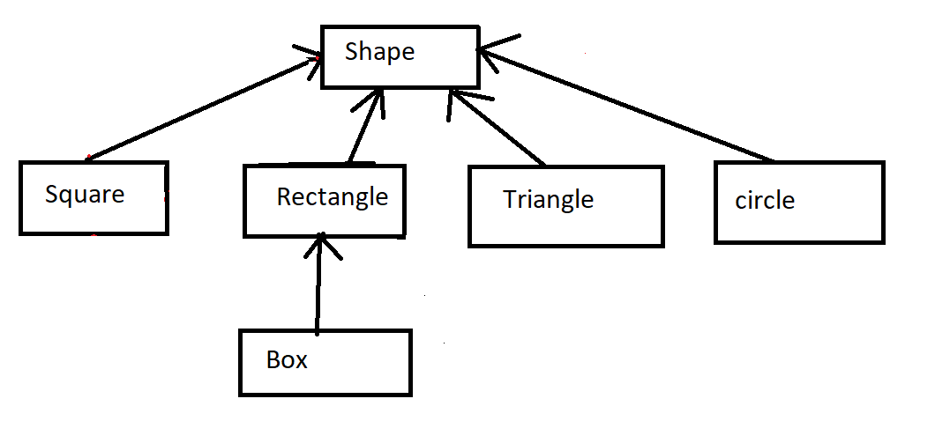
Introduction to Association
IS A Relation
IS A
IS A
IS A
IS A
IS A

Slide 5
Introduction to Association
One-to-One Association
A person can have only one passport. That is a one-to-one association.
HAS a
Person
1
1
Passport

Slide 6
Introduction to Association
One-to-Many Association
If we talk about the association between a Bank and Employee, a bank can have many employees, So it is a one-to-many relationship.
HAS
Bank
1
1 .. n
Employee

Slide 7
Introduction to Association
Many-to-One Association
If we talk about the association of a classroom, for many students there is one teacher. So it is a many-to-one relationship.
HAS
Student
1 .. n
1
Teacher

Slide 8
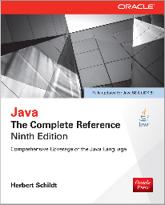
Books
Java The Complete Reference- Ninth Edition by Herbert Schildt

Slide 9
References
https://docs.oracle.com/javase/tutorial/

